Slide 1
Industry 4.0
Prepared by
Ravi Gupta
Dr. Mirjana Stankovic
Dr. Juan Figueroa

Slide 2
THINK ABOUT THE FUTURE- AFTER ALL YOU WILL LIVE IN IT!

Slide 3
Industry 4.0 Paradigm
Interoperability
Virtualization
Decentralization
Real-Time Capability
Service Orientation
Modularity
Convergence
Cost reduction and efficiency
(i) Factory and nature: improvements in resource efficiency and sustainability of manufacturing systems,
(ii) Factory and local communities: increased geographical proximity and acceptance, integration of customers in design and manufacturing processes,
(iii)Factory and value chains: distributed and responsive manufacturing through collaborative processes, enabling mass customization of products and services and
(iv) Factory and humans: human-oriented interfaces and improved work conditions.

Slide 4
Main concepts related to Industry 4.0 covered by the background paper
Convergence
Mass Customization
Cyber Physical Systems
Internet of Things
Industrial Internet of Things
Internet of Services
Internet of Energy
Big Data, Data Mining and Data Analytics
Artificial Intelligence
Augmented Reality
Industrial 3D printing (Additive manufacturing)
Blockchain

Slide 5
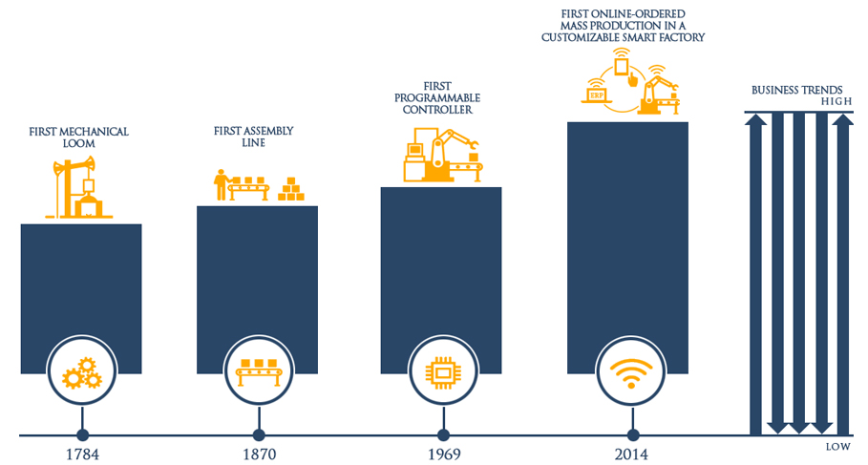
3

Slide 6
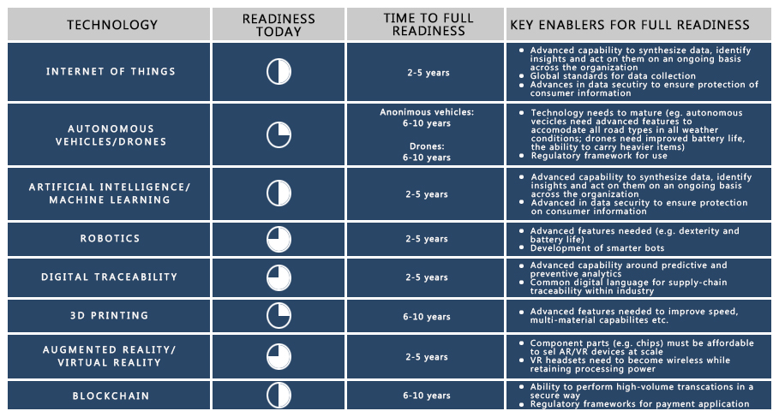
5

Slide 7
Industry 4.0 opportunities

Slide 8
”
Industry 4.0 opportunities/threats
Premature deindustrialization?
Can developing countries leapfrog?
Production of advanced manufactured goods (e.g. wearable tech, autonomous vehicles, biochips and biosensors, and new materials) is most likely to co-locate with R&D facilities in high-income economies.
While previously FDI followed cheap labor, labor cost differentials might no longer play such an important role with Industry 4.0.
A key question will be whether Industry 4.0 and the continued rollout of Industry 3.0 will weaken the industrialization prospects across a broad range of developing countries or whether they will create new potential to boost manufacturing output and exports and leverage them for growth.

Slide 9
Industry 4.0 opportunities
Some developing countries might be able to leapfrog thanks to their high-skilled, ICT heavy skilled workforce
Industry 4.0 technologies create the opportunity for developing countries to bypass traditional phases of industrial development:
Online and mobile banking is reducing the need to build networks of physical bank branches.
Localized renewable energy production, such as solar power coupled with new battery storage technology, could reduce the need for investing in expensive power distribution networks
Drones could help to deliver lightweight, high-value goods such as medical supplies to remote regions with poor transport infrastructure

Slide 10
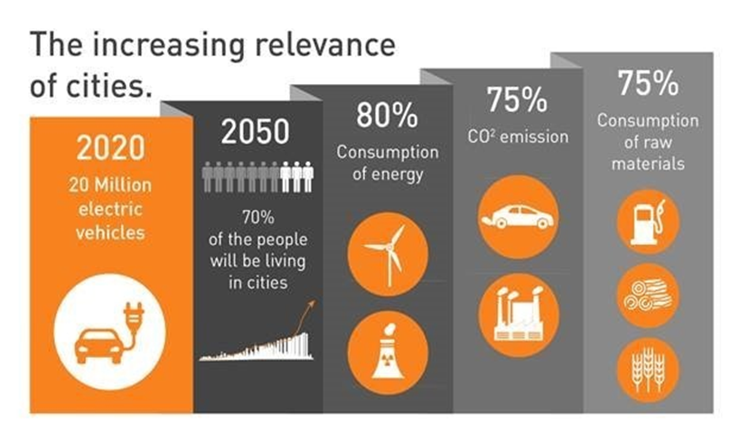
Changes for companies
Industry 4.0 opportunities
Industry 4.0 and the circular economy
Smart cities
Bringing products to market faster
Machines perform independent quality checks errors detected and remedied faster
Smarter resource management based on energy data leads to optimized equipment maintenance
Improved stock management via using chips and sensors
Improved prediction for demand through data mining improved supply chain and inventory management

Slide 11
Infrastructure in developing countries
Industry 4.0 opportunities
The Not So World Wide Web
Estimated number of internet users per 100 inhabitants in 2016
Europe
CIS*
79.1%
66.6%
Energy 4.0 infrastructure
ICT infrastructure
41.6%
65.0%
Arab States
41.9%
The Americas
25.1%
Asia & Pacific
Africa
47.1%
Worldwide
* Commonwealth on Independent States

Slide 12
Industry 4.0 challenges

Slide 13
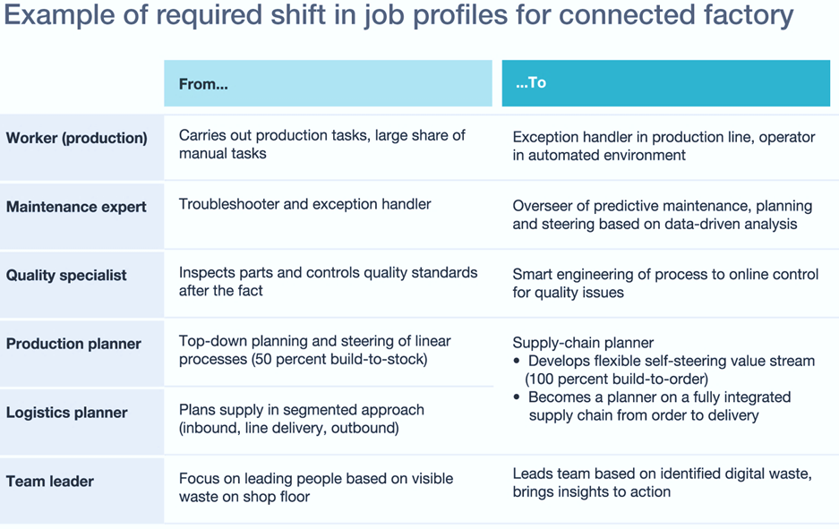
Jobs, skills and education
Industry 4.0 challenges

Slide 14
Industry 4.0 challenges
Legal implications
Ethical implications
Data security, protection and privacy
Intellectual Property
Liability
Black boxes
Biased algorithms

Slide 15
Standards
If the appropriate solutions are not developed there is a danger that isolated, proprietary standalone or silo solutions could emerge. This would expose purchasers of Industrie 4.0 solutions to the risk of technological lock-in, resulting in technological dependence and high costs if they wished to switch to a different solution.
Open systems are thus of particular importance to small and medium-sized enterprises whose relatively limited influence makes them more reliant on the existence of interoperable systems for accessing what is potentially a very large market
Take advantage of the benefits of standardization at an early stage of development. Ensure that aspects of standardization are integrated into national and international research projects, and suitable standards work is initiated at the R&D stage, and standardization is taken into account from the beginning.

Slide 16
Human centered governance model in Industry 4.0

Slide 17
Urgent need for a bold policy agenda to confront the development challenges posed by Industry 4.0, combined with a visionary narrative about the improvements in everyday life that Industry 4.0 can bring to households, countries and humanity at large.
Human centered governance model in Industry 4.0

Slide 18
Human centered governance model in Industry 4.0
Create flexible, informal process involving business, government & social actors to better manage new technologies’ risks.
Shorter feedback loop between innovators and society (policymakers track rapid advances in science/better understand when & what formal rules are appropriate)
Standardization and interoperability: voluntary principles, standards & pilot programs agreed among key stakeholders (manufacturing, academic & insurance industry experts work on common safety protocol for digital security in IoT).
Reliable physical and digital infrastructure needed

Slide 19
Human centered governance model in Industry 4.0
Governments need to place social inclusion at the heart of the economic policy.
Develop alternative measures of national economic performance: e.g. the Inclusive Development Index, developed by WEF.
Education. The children of today will be the leaders of the 4th Industrial Revolution. Reconsider how we educate them.
Replace exam-focused approach with empowerment and support of children’s ability to curate, analyze and evaluate what they’re reading or seeing online, not merely consume it.
Build trust. People should participate in the digital economy on a level playing field with their peers, without fear of abuse.

Slide 20
4IR and Inclusion.
Use emerging technologies for delivery of social services and public goods
E.g. Use blockchain for land registration
Build/Strengthen innovation ecosystem that fosters business models based on 4IR aimed at inclusion
E.g. AI to complement/supplement health care for marginalized
Policies that allow broader absorption of technologies and not just de novo firms.
E.g. SMEs grow up the value chain

Slide 21
4IR and sustainability, natural wealth, gender
Use emerging technologies for sustainability
E.g. drone to monitor illegal logging, blockchain to create carbon markets
4IR can be leveraged to bring about greater resource efficiency
E.g. Use IOT to reduce energy wastage thus reducing carbon footprint
4IR can automate many routine jobs leaving more free time for women to pursue productive activities
Gender gap in STEM could mean absent proactive gender sensitive policies, female participation in tech businesses could worsen

Slide 22
The role of ITD and
international organizations
Awareness building knowledge events about the Industry 4.0 consequences for inclusive and sustainable industrial development (ISID)
Formulating innovation management standards for leapfrogging into Industry 4.0
Multi-stakeholder knowledge sharing platforms
Tools and methods for innovation management
Designing training curricula for new workforce skills requirements
Methods and best practices to support SMEs digital transformation and bridging the gender digital divide
Technical assistance on capacity building and technology transfer and absorption
Building awareness among policy makers and industry associations on the issues of new infrastructure, standards and policy

Slide 23
Insufficiency of the current regulatory framework Spatial issues with respect to the regulatory framework: Where to regulate? Time issues with respect to the regulatory framework: When to regulate? Who regulates?
The way forward

Slide 24
Thank you!
ravi@tivinc.com

